Slide 1
End of life care survey results

Slide 2
Methodology
Survey sent to 1,000 people
Even split across genders and age groups
Covering the four nations

Slide 3
End of life care is support for people who are in the last years of their life. The Gold Standards Framework is a leading training provider for staff who care for people in their last years. The framework aims to ensure people live well and die well in the place and manner of their choosing. If you were able to choose, where would you prefer to die?

Slide 4
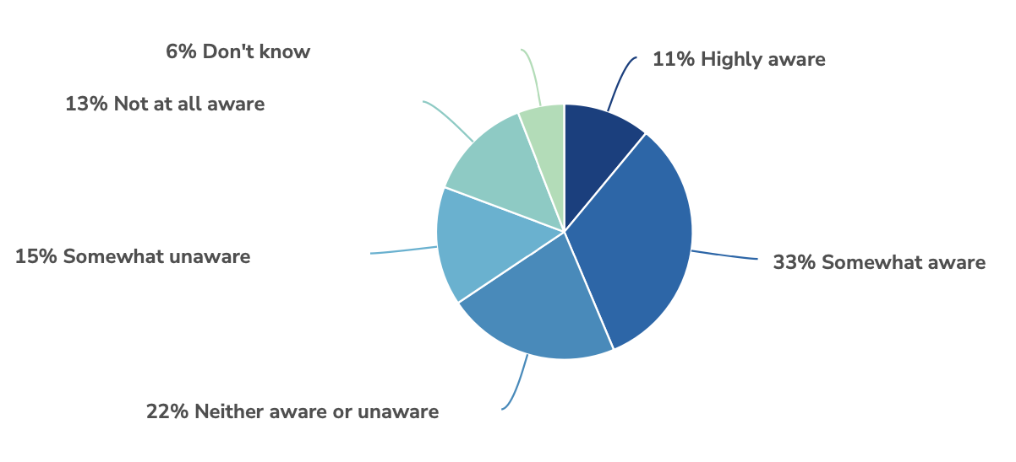
To what extent, if at all, are you aware of the care and support available to you when nearing the end of your life?

Slide 5
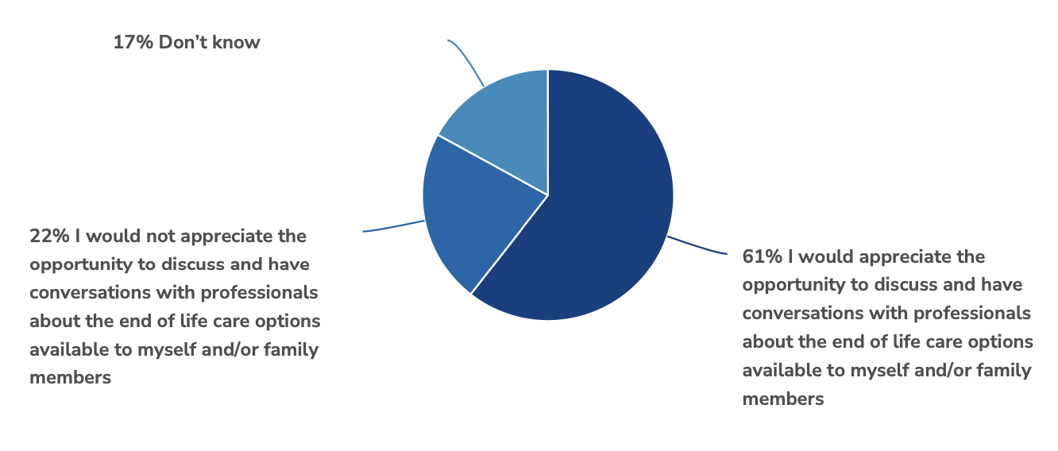
Which of the following statements is closest to your view?

Slide 6
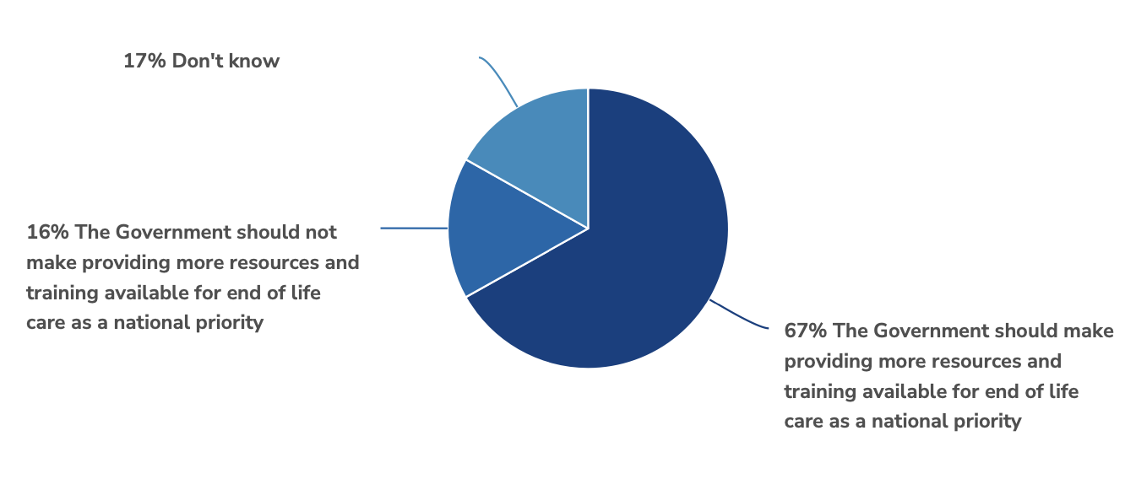
Which of the following statements is closest to your view?

