Slide 1


Slide 2
With the End in Mind
Kathryn Mannix
‘Deathwife’
@drkathrynmannix

Slide 3
How many deaths have you been involved with?
Recognising the approach of death
Involvement in end-of-life care
Present as breathing stopped
How do those deaths compare with media deaths?
Newspapers
Soap operas
Films

Slide 4
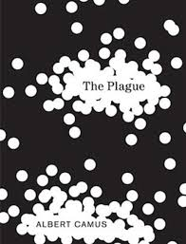

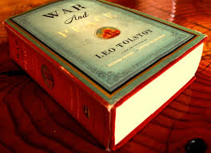
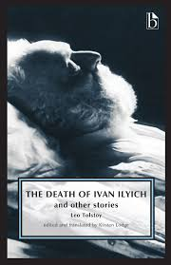
Once upon a time…
UNREALISTIC
Notes:
Literature and art are better portraits of the transcendent, but readers are fewer.

Slide 5
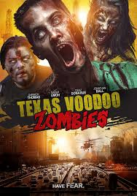
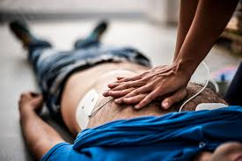
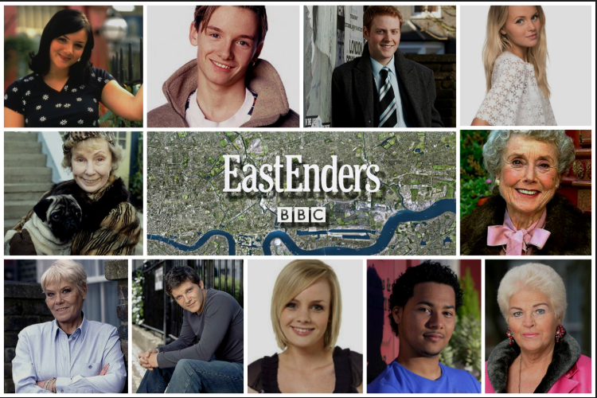
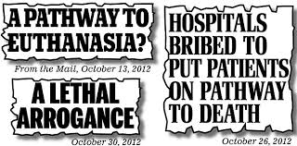
Modern Death Myths
Notes:
21st C awareness of death
Bad Deaths on screen
Unhelpful media reports
Death-as-Entertainment
Unrealistic expectations

Slide 6
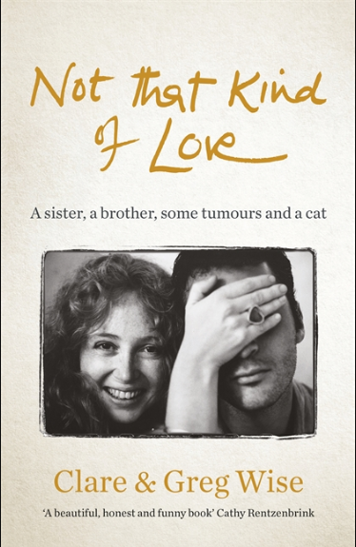
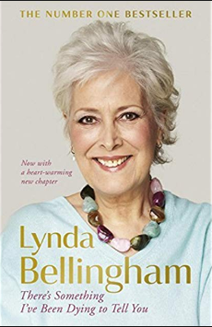
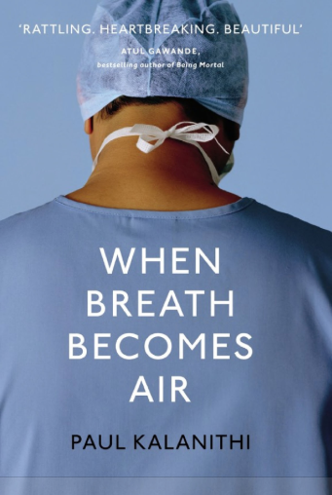
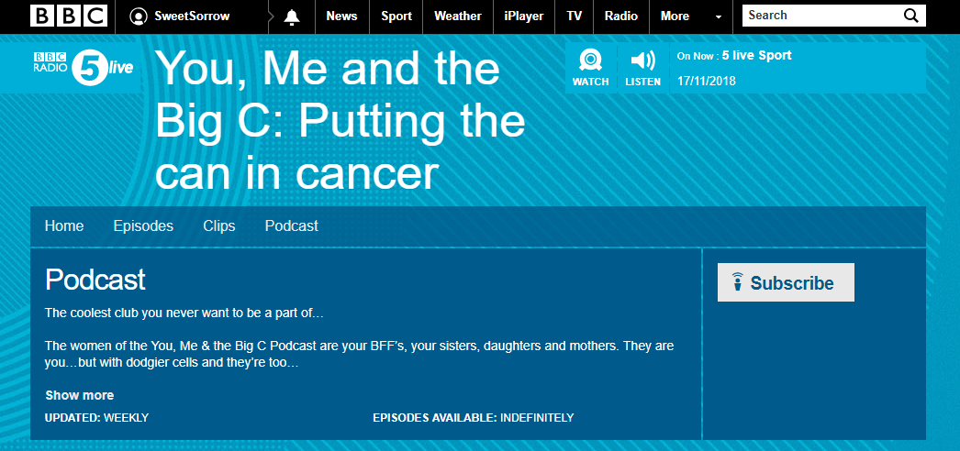
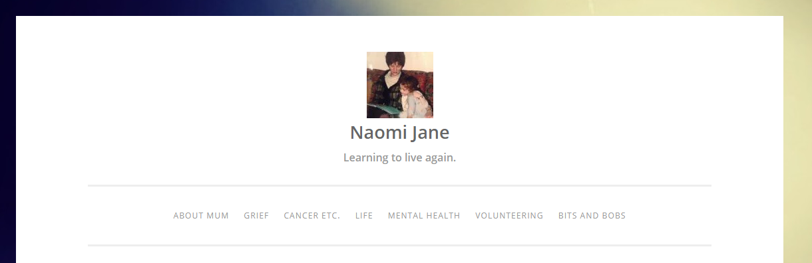

New Ways of Telling Stories
Notes:
You, Me, Big C
Naomi Barrow, Fiona Hicks’ daughter
Clare Wise
Lynda Bellingham, Paul Kalanithi – autobiography, differing levels of medical insight
Greg & Clare – mix of auto/biography and perimortality reflection by Greg

Slide 7
What about our stories?
As death approaches
What are the patterns you recognise?
How do you know when to advise families to send for significant others?
How do you advise families to behave at the bedside?
How do you narrate the deathbed?
Notes:
Pattern recognition
Wisdom
Calm voices; speak, touch, soothe, relax

Slide 8
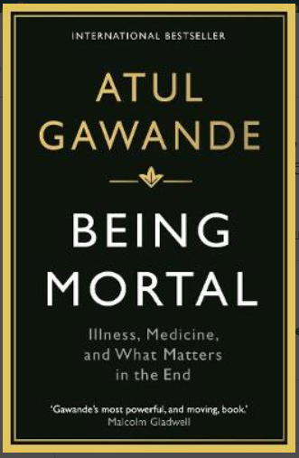
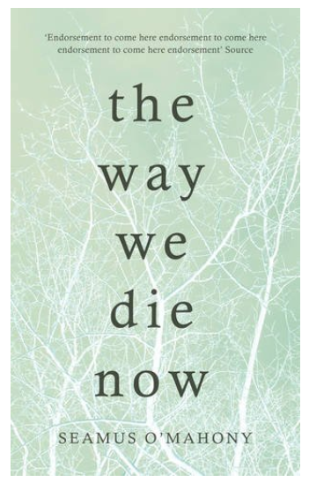
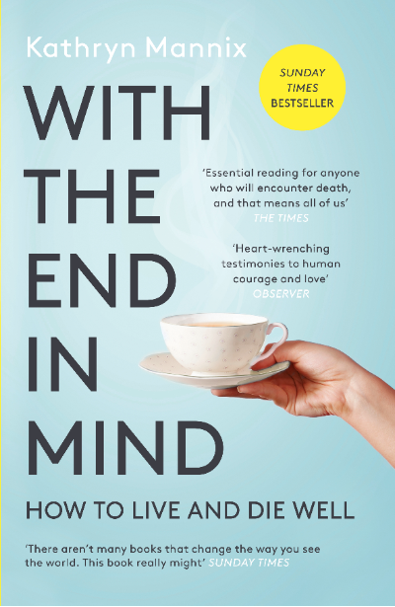
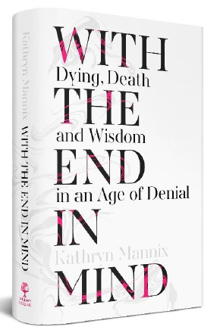
Telling our stories
Notes:
Multiple stories, showing patterns and usual processes, noting exceptions, offering insights and guidance

Slide 9
Everyone needs to know this…
What is dying like?
Can I bear it?
Will it frighten my family?

Slide 10
Sabine

Slide 11
What can we learn from Sabine’s story?
Did anything surprise you?
Did anything shock you?
Did you recognise anything?
Notes:
A moment to reflect on the learning

Slide 12
Sabine – retelling the story
Being ‘Midwives’ of dying:
Preparation
‘Antenatal care’
D-day(s)
Notes:
Prep: planning ahead; info; teamwork
Antenatal care: symptom management, preserving fitness, preparing for safe labour
D-day(s): reminders; encouragement; compassion; family/companions as well as patient

Slide 13
Changing the Public Understanding of Dying
Every patient offers us a new opportunity to change understanding of a whole ‘Village.’
Every death is individual, yet the patterns are familiar.
It’s time to re-claim the D-words.
It’s time to talk about dying.
It’s time to narrate every death-bed.
It’s time to change the public understanding of dying.

Slide 14
Does our work always allow the collaborative creativity that keeps the end in mind?
Doing Death Differently

Slide 15
Thank you
Thanks to GSF team for inviting me to contribute.
Thanks to the families and teams who taught me.
Thanks to William Collins Publishers for daring to back a book about dying.

