Slide 1
Implementing the Gold Standards Framework cross boundary in Jersey 2015 - to date
Presented by Gail Edwards: Nurse Champion, Jersey Hospice Care

Slide 2
Background
2014/15 review of health care provision in Jersey
Jersey Hospice Care (JHC) recognised as end of life care specialists
JHC commissioned to enhance the quality, consistency + equity of palliative and end of life care island wide
2015 Jersey GSF Cross Boundary Care Programme commissioned
Nurse Champion appointed
Jersey General Hospital (JGH) End Of Life Care Facilitator appointed
Staged 3-year programme – JHC, Primary Care, Care Homes, Approved Home Care Providers, Family Nursing & Home Care (FNHC), Hospital & Community Services
Notes:
Considerable variation in EOLC delivered in different care settings

Slide 3
Aim of implementing GSF
Quality improvement initiative of island wide end of life care
Enable / support Jersey whole-system transformation of health and social care provision
Alignment of consistent high quality end of life care with patient’s preferences
Pre-planning and anticipation of needs
Improve staff confidence and teamwork
More home based, less hospital based care
Notes:
JHC’s objective = to enable an island wide transformation of care for all people in their final year(s) of life in any setting

Slide 4
Methodology
Primary Care
Going for Gold programme
DVD sessions supported by NC, JHC CNS + FNHC
Care Homes programme / JHC
6 workshops
Acute Hospital programme
Jersey General Hospital
6 workshops
Emergency services
Ambulance
Public awareness
Talks, display boards, leaflets
Home Care Providers programme
Train the Trainer
Cross Boundary Care events
Notes:
68 0rganisations = 25 care homes, 10 acute hospital wards, 11 PC practices, JHC, FNHC, 16 Home Care Providers

Slide 5
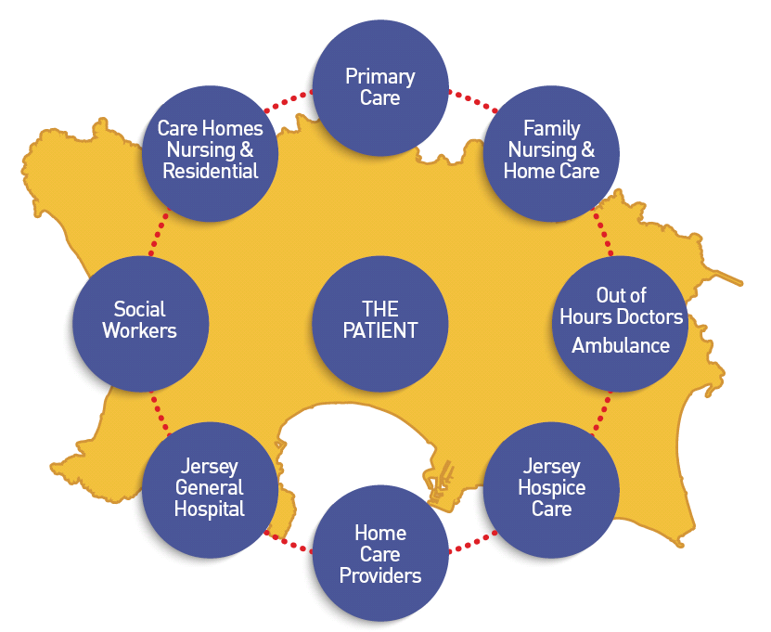

Slide 6
Challenges
Lack of financial incentives
Funding
Credibility of GSF – mainly an unknown approach in Jersey
Culture of health care
Attitudes – advantages to practice not apparent by all staff
Resources
Responsibility of GSF champions/coordinators
Time consuming – organisational capacity
Lack of staff confidence
Negative attitude to change
Varying attendance at training sessions
Staff turnover

Slide 7
Mixed method evaluation of the impact of the whole-system GSF cross boundary care programme
Quantitative data | 68 organisations implemented GSF 28% returned both Pre + Post data | Key Outcomes Ratio Organisational Level Questionnaire After Death/Discharge Analysis Staff Survey
Qualitative data | 28 semi-structured telephone interviews with relatives, care providers from different settings + other stakeholders | Open ended questions about impressions/reflections of the impact of GSF; both positive + negative, anonymised + grouped by setting and/or role
Notes:
To demonstrate change

Slide 8
Overall impact
“Significant progress in key areas both in individual settings and in island wide service provision as a whole”
Improved quality of patient care
Empowered patients
Earlier planning, more choices
Better joined-up coordinated care
Brought teams together e.g. in primary care
unnecessary hospital admissions
Notes:
Fundamental change that is improving patient outcomes, quality of care +
experiences of services
HCPs focused on what really matters to patients How? By organistaions
New care model – fundamental change that is improving patient outcomes, quality of care/patient experiences
Whole system transformation across all areas
Integrated end of life care provision
= person centred care
Pg 7
The ability to introduce and normalise ACP discussions and support communication of peoples’ preferences to different locations including urgent and OOH care (eg. Ambulance, A+E etc) was particularly impressive, an area that causes difficulty for many
Has helped significantly reduce the number of people dying in hospital – 26%. More of a ‘one-system’ support for patients.”

Slide 9
“Empowered patients to feel part of their care”
“.. care more joined up and communication is better”
Earlier identification
Advance Care Planning discussions
Meeting Preferred Place of Care and Death
Staff confidence
Communication
“The hospital are much more aware of patients’ needs and they help discharge patients more quickly to their preferred place of care”
“The whole system has become more robust and accessible”

Slide 10
Jersey uniqueness
Prof K Thomas (2019) The Jersey GSF Cross Boundary Care Evaluation Report – 2015-2018
“The ‘closed’ system on the island represents a cross-boundary site like no other. Lessons from this should be integrated into policy drivers and incentives, including professional, financial and legislative levers where needed”

Slide 11
Findings .... are very encouraging suggesting that it has catalysed significant improvements in well-coordinated integrated end of life care across the whole island
The progress made in all areas, and particularly in the coordination whole island approach, has been impressive

Slide 12
Conclusion
Introduction of GSF successfully functioned as a vehicle for change in Jersey
Strong evidence of achievement of culture change
Significant success in integrated cross-boundary care across Jersey
Significant impact on levels of understanding, knowledge, skills + quality of care
Notes:
Common culture – ‘everyone talks the same language’
Culture change has long been identified as a key ingredient for embedding changes in healthcare practice
- this evaluation therefore also makes an important contribution to wider work in this area

Slide 13
“ We suggest that this has been an excellent start in the implementation of GSF to every setting across the whole island of Jersey and the integration of GSF within all settings and across all boundaries, enhancing a common culture of care has been outstanding ” Prof K Thomas (2019) The Jersey GSF Cross Boundary Care Evaluation Report – 2015-2018

Slide 14
JHC’s commitment to sustaining GSF
GSF Regional Training Centre
Included in organisation’s strategic aims and culture
GSF included in Jersey policy guidance e.g. Jersey Quality Improvement Framework, Jersey Nursing Assessment and Accreditation System, Jersey Care Commission Care Standards
Accreditation
Train organisations not currently GSF trained
Further workshops to build on good practice
Cross Boundary Care events
Notes:
Responding to the needs of the ageing population
Pg 16
‘much valued events’
‘became vehicles for change and should be continued to inform and motivate all to continue improvements, building on the success achieved to date’
GSF Strategic Leadership Group

Slide 15
Care Homes
JCC Care Standards aligned to GSF Accreditation key tasks
Programme for HCAs
Biannual programme for RGNs
Accreditation workshops
New cohort
Training in care homes
Support visits – Reflective sessions
Currently
Allied healthcare professionals
Primary Care
Evolving GSF Supportive Care register meetings
Receptionist/Admin staff training
1 practice accredited√
FNHC/Rapid Response and Reablement Team
Approved Home Care Providers
Ongoing support
Jersey Hospice Care
Accredited √
Strategic culture, GSF in business plan
Regional Training Centre
Jersey General Hospital
GSF Champions + CNSs programme
Quality Summit
SPCT support
Cross Boundary Care events

Slide 16
Thank you gailedwards@jerseyhospicecare.com
“Any change requires a significant investment of time, financial resource and leadership effort.”
NHS Institute for Innovation and Improvement

