Slide 2
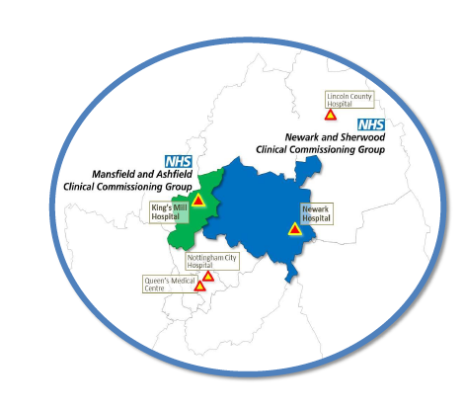

Slide 3
Ambulance
Compassionate
Community
Hospice
OOH

Slide 4
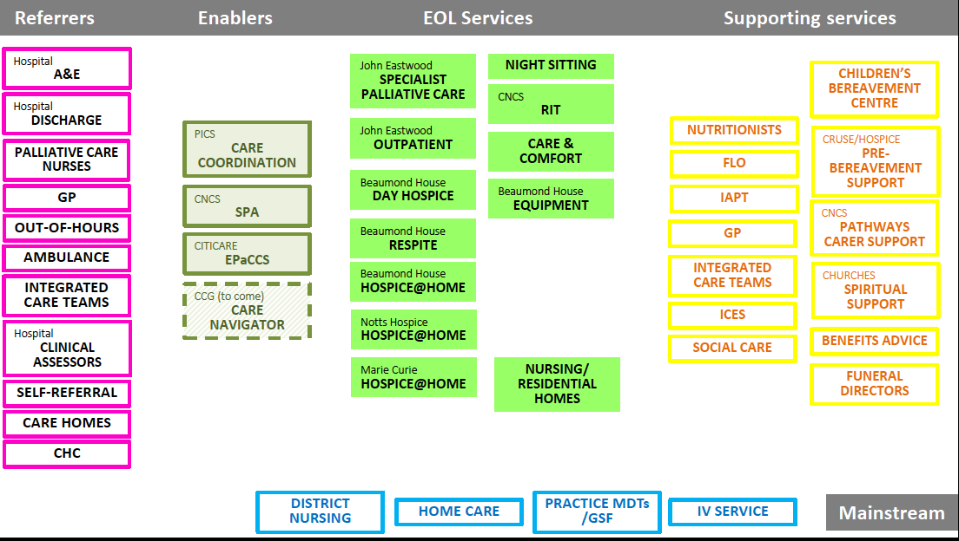

Slide 6
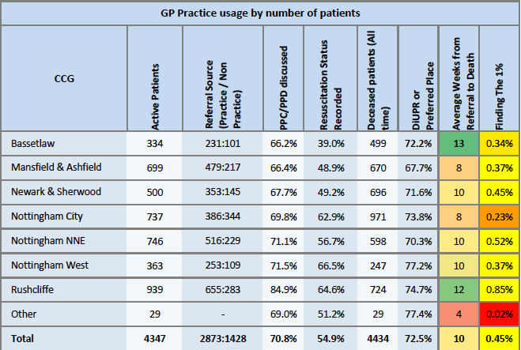

Slide 7
Advance Care Planning
Guidance for Clinicians
Suggested script to introduce the ACP document
‘This document will help you plan ahead with the help of those closest to you and those of us helping you with your care. It is designed to guide you through some useful and important decisions you may wish to make.
It is a good way to record information about what is important to you and although it is not legally binding or a replacement for good communication with you it should be used as a guide if you are not able to communicate clearly at any time. You can review and change it at any time.
Have a look at it in your own time and with your family or anyone else you feel should be involved in supporting you. If you would like to ask me to help you or need me to explain anything to you in more detail we can arrange a good time to do this together.’

