Slide 1
Frailty is the future- challenges and ideas
Premila Fade
Consultant Geriatrician LNWH NHS Trust
Lead for end of life care British Geriatrics Society

Slide 2
Ageing population
Older population expansion in England will accelerate next 20 years
Over 65s will ⬆ from 17% (2010) to 23% by 2035
England in 2014: 9.5 million aged 65+; 471K aged 90+
By 2035 there will be 14.5 million 65+ and 1.1 million 90+
15 million live with a long term condition (LTC)
58% people with a LTC are over 60 (14% under 40)
A&E attendances by people aged 60+ by two thirds 2007 to 2014
2010-15: 18% ⬆in emergency hospital older people admissions

Slide 3
The burden of multimorbidity
Applying NICE guidelines to a 78 year old woman with previous myocardial infarction, type-2 diabetes, osteoarthritis, COPD, and depression…
11 drugs (and possibly another 10)
9 lifestyle modifications
8-10 routine primary care appointments
8-30 psycho-social interventions
Smoking cessation appointments
Pulmonary rehabilitation
“I’d like my life back please!”
Hughes et al Age & Ageing 2013

Slide 4
What is frailty?

Slide 5
What is frailty?
Minor stressors trigger disproportionate change in health status
‘MINOR ILLNESS’
INDEPENDENT
FUNCTIONAL ABILITY
DEPENDENT
Unpredictable recovery

Slide 6
Frailty is a distinctive health state related to the ageing process in which multiple body systems gradually lose their in-built reserves.
Around 10% of people aged over 65 years have frailty, rising to 40% of those aged over 85 years .
Older people living with frailty are at risk of dramatic changes in their physical and mental wellbeing after an apparently minor event which challenges their health, such as an infection or new medication
Many people with multiple long term conditions also have frailty which may be masked when the focus is on the long term conditions.
Some people are frail but do not suffer from any chronic diseases and may not be known to their GP (until they become bed bound, immobile or delirious as a result of an apparently minor illness).
There is overlap between the management approaches for people with multi-morbidity and those with frailty but these conditions are not identical.
There is also overlap between frailty and physical disability – many people with frailty also have disability, but lots of people with a long term disability do not have frailty.

Slide 7
Frailty phenotype- sacropenia
unintentional weight loss
Reduced muscle strength
Reduced gait speed
Self-reported exhaustion and
Low energy expenditure.
Generally individuals with three or more of the characteristics are said to have frailty

Slide 8
Dalhousie clinical frailty scale (Rockwood)

Slide 9
Screening tests for frailty
Gait speed
Timed up and go test
taking more than 5 seconds to walk 4 m using usual walking aids if appropriate.
with a cut off score of 10s to get up from a chair, walk 3m, turn round and sit down

Slide 10
Prisma 7 Questions a cut-off score of >3
1) Are you more than 85 years?
2) Male?
3) In general do you have any health problems that require you to limit your activities?
4) Do you need someone to help you on a regular basis?
5) In general do you have any health problems that require you to stay at home?
6) In case of need can you count on someone close to you?
7) Do you regularly use a stick, walker or wheelchair to get about?
Good sensitivity but only moderate specificity for identifying frailty.
There are many fitter older people who will have a positive test result (false positives).
For example, only one in 3 older people (over 75 years) with slow walking speed has frailty

Slide 11
Frailty syndromes
1] Falls e.g. collapse ?cause, legs gave way, ‘FOF- found on floor’.
2] Immobility e.g. sudden change in mobility, ‘gone off legs’ ‘stuck on toilet’.
3] Delirium (acute confusion), sudden worsening of confusion in someone with previous dementia or known memory loss.
4] Incontinence or change in continence – new onset or worsening of urine or faecal incontinence.
5] Susceptibility to side effects of medication e.g. confusion with codeine, hypotension with antidepressants.

Slide 12
Why does frailty matter?

Slide 13
Why does frailty matter
Even apparently simple interventions like a move to a short term residential placement for respite, a trip to the local emergency department after a fall or the trial of a new analgesic can have unforeseen and adverse outcomes
Minor physical illness can cause profound deterioration in health
Linked to higher risk of complications from hospitalisation – pressure sores, delirium, loss of weight, immobility
Longer length of stay in hospital
Worse outcome – death and disability
Less benefit and more side effects from medication

Slide 14
End of life trajectories

Slide 15
The electronic Frailty Index (eFI) Development and validation of an electronic frailty index using routine primary care electronic health record data A Clegg et al Age and Aging 2016; 45: 353-360
The electronic frailty index (eFI) is a scoring system which uses existing electronic health record data to identify and severity grade frailty.
The eFI uses the cumulative deficits model of frailty.
The eFI is calculated by the presence or absence of 36 deficits including clinical signs, symptoms, diseases and disabilities.
The eFI calculates a frailty score E.G. if a patient has 9 out of 36 deficits, the eFI score is 0.25.
The score is a predictor of those who are at greater risk of adverse outcomes E.G. care home admission and mortality.
The eFI was developed and validated using data from approx 500,000 patients.

Slide 16
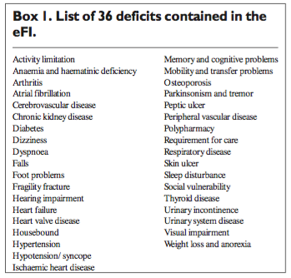
Electronic Frailty Index (eFI)
Clegg et al: Age Ageing2016: 45:353-360

Slide 17
eFL score and categories
Fit (eFI score 0 -0.12): No or few long-term conditions that are usually well controlled. Independent in day to day living activities.
Mild frailty (eFIscore 0.13 –0.24): Slowing up and in need help with activities of daily living such as finances, shopping, transportation.
Moderate Frailty (eFIscore 0.25 –0.36): Limited outdoor activities and mobility problems or require help with personal activities such as washing and dressing.
Severe Frailty (eFIscore > 0.36): Dependent for personal care and have a number of co-morbidities. At risk of dying within 6 -12 months

Slide 18
What to do about frailty?

Slide 19
What to do about frailty
Prevention – regular exercise, healthy diet, warmth, social activity
Vaccinations, alcohol and smoking cessation
Comprehensive and holistic review of medical, functional, psychological and social needs in partnership with older people who have frailty and their carers
Medication review- less benefit, more side effects
Mental health review
A urine dip should not be used to diagnose a urinary tract infection, it can be misleading.
Older people should not be routinely catheterised unless there is evidence of urinary retention
Forward planning
Consider the risks and benefits of hospitalisation
Consider the role of disease orientated medical care
CPR

Slide 20
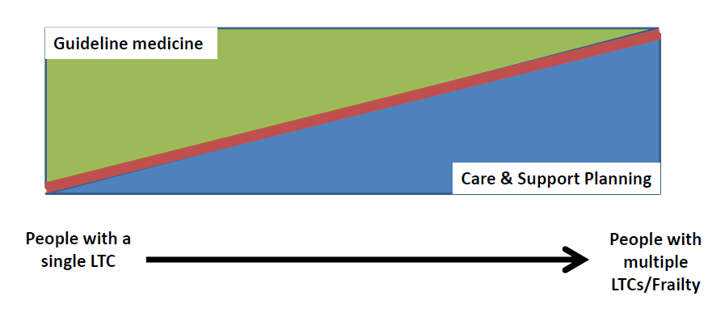
Guidelines not tramlines
..the frailty challenge

Slide 21
Key points: what can we do now?
Early identification of frailty
Targeted advance care planning
for those with high index frailty
Integrate frailty care: trusted assessors & senior decision makers
Move emphasis away from hospital admission
Temporisation in crisis: ‘assess to admit’
Navigation towards more appropriate community responses
Early de-escalation from hospital: ‘discharge to assess’
Trigger and track using frailty to target those at risk of DTOC

