Slide 1

Effective Planning and Care Coordination to Improve Outcomes in Palliative Care
Fiona Widdowson – End of life Care Facilitator
Notes:
Thankyou very much for the opportunity to share some of our work trying to improve the experience of people who are approaching the end of their life- and supporting those people important to the patient

Slide 2
What is the Goldline
24/7 telephone service for any patient thought to be in the last year of life (LYL) in AWC and Bradford.
Includes full support for carers of those in LYL
Senior nurse led service based at Airedale General Hospital
Linked to entry onto Gold Standards Framework
Aiming to offer to all people who can be identified as likely to be in last months/year of life

Slide 3
How does it work?
Patients identified as potentially in LYL –community / hospital
Professional has sensitive conversations, explains aims of GSF
Seeks consent for being part of GSF, Goldline and and to share record with Goldline-info. given
Electronic referral made via System1 EPaCCS template ( via fax for care homes at present)
Hub admin. receive task on S1, accept referral and add patient to GL caseload
  Full health record and EoL info. available to hub at point of call
Notes:
Bradford hospital using fax. Herncliffe care home – fax in directly with GPs authorisation.
EPaCCS template – used daily sharing all information ( communication) Makes care coordination so much easier and efficient. Better populated EPPACs – more efficient care

Slide 4
Reassurance/advice
Coordination
Simplicity
Knowledge
Patient focused
Key Values

Slide 5
Call outcomes (excluding calls to report death n = 916 )
Patient remained in place of residence | 97%
Ambulance called to assess | 3 %
Disposition after call, year ending March 2019

Slide 6
Onward Referrals of the 13,925 calls (calls excluding reported deaths n = 916)
43 % Resolved by the Goldline team needing no onward referral
34% District nurse
11% OOH GP
8% In hours GP
2% Palliative care CNS
1% Multiple referrals
>1% Collaborative Care teams
>1% Palliative Care Consultant
>1% Social Services

Slide 7
Governance / Quality
Consultant audit of all calls (2 months)
Call management system including recording calls
Nurse consultant and hub manager listens to % all calls
Health professional feedback forms
Patient feedback

Slide 8
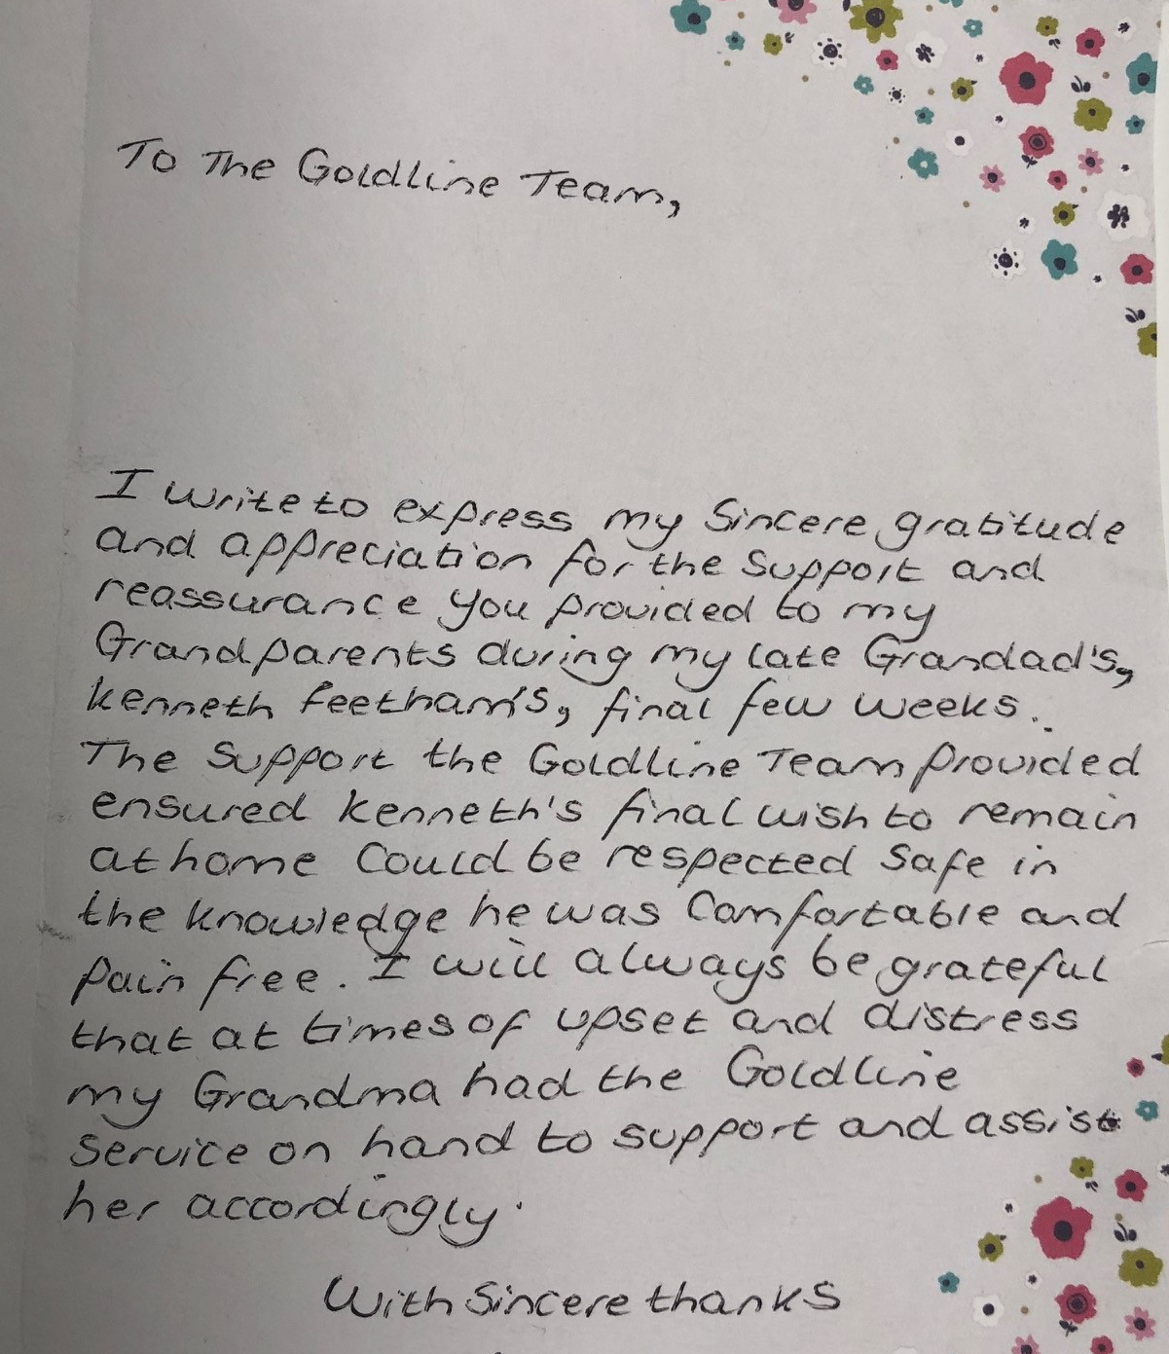
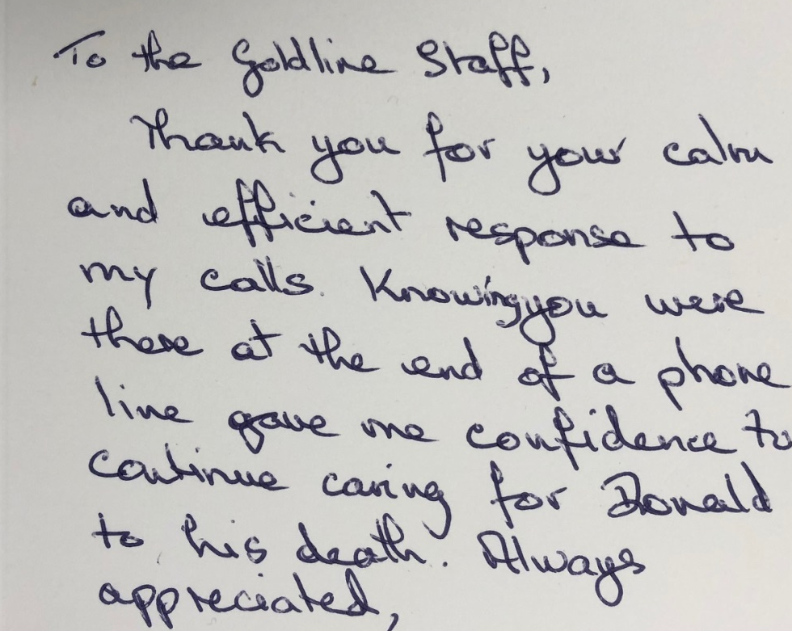
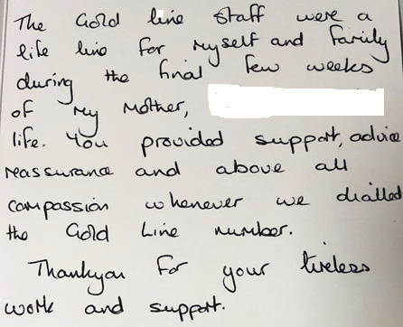

Slide 9

Gold Line http://www.health.org.uk/gold-line http://www.airedaledigitalcare.nhs.uk/

