Slide 1




Introducing Advance Care Planning Workshop
Amanda Taylor Carolyn Mizen
EoLC Facilitator End of Life Care Facilitator
RGN, Dip(ed), BA (Hons) RGN, Dip(ed) Palliative Care
PGCPE, MSc NMNP

Slide 2
During this session…
Refresh regarding the definition & elements of ACP
Gold Standards & ACP
Sharing experience of introducing ACP
  Challenges
  Potential solutions
  Resources
Top tips….

Slide 3
Advance Care Planning
a voluntary process of discussion & review
… to help an individual who has capacity
… to anticipate how their condition may affect them in the future
&, if they wish
set on record choices or decisions relating to their care & treatment
…so that these can then be referred to by their carers (whether professional or family carers)
… in the event that they lose capacity to decide once their illness progresses
(NEoLCP, 2011)

Slide 4
ACP & Mental Capacity Act
Advance Care
Planning
Advance statement
of wishes &
preferences
Advance Decision
to Refuse Treatment
Lasting Power of
Attorney
What you do want
What you don’t want
Who you want to speak for you
blue = advisory; purple = legally binding

Slide 5



Digital legacy & assets?
Digital legacy - information that is available about someone after their death eg social media profiles, photos
Digital assets - possessions that are made from computer code & exists in different forms
www.DigitalLegacyAssociation.org

Slide 6
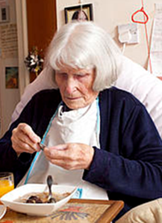
Janet’s Definition of ACP
‘its where I’ve told them all what’s important to me & they are going to try to make it happen… I can rest with that’

Slide 7


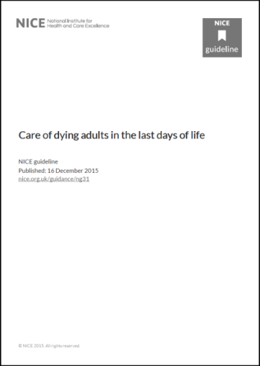





Policy drivers

Slide 8


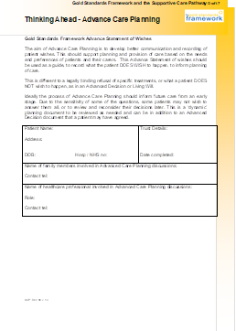
‘Must Do’ Key Task
ACP discussions (or best interest discussions) are offered to every resident

Slide 9
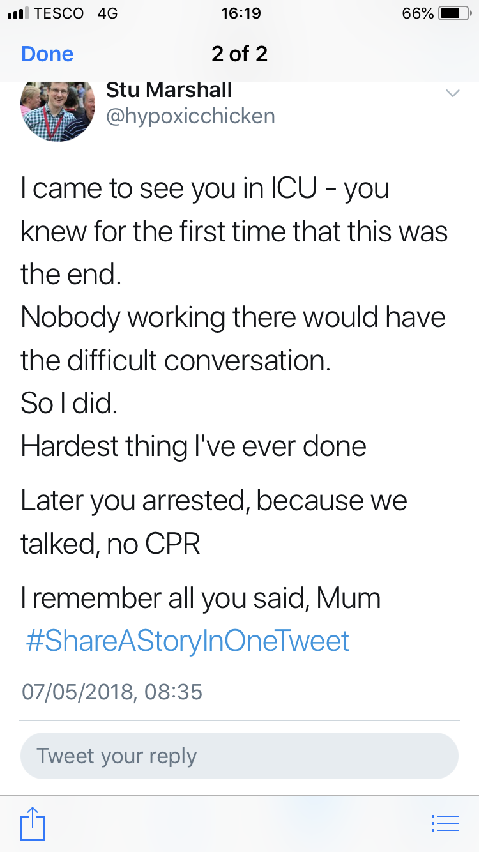
Stu Marshall@hypoxicchicken......

Slide 10

How do we introduce ACP?
Discuss 2 main challenges you have encountered & the potential solutions ?

Slide 11



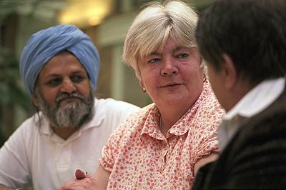

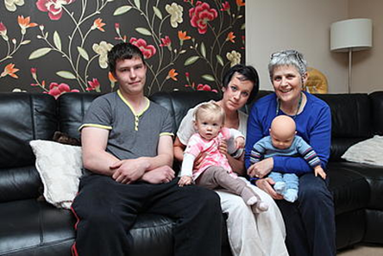
How do we introduce ACP?

Slide 12








Resources

Slide 13

Top tips……
Take a population based approach – ACP for all who want it !
Take opportunities as they arise
Go with the flow – Never insist on an ACP discussion
Don’t expect a person to rush into making plans – ACP is a process not an event
Have a variety of resources/approaches
Work in collaboration
Share success and learning

Slide 14
References and resources
Abel J, Pring A,Rich A, Malik T, Verne J (2013) The impact of advance care planning of place of death, a hospice retrospective cohort study. BMJ Supportive & Palliative Care, 3:168-173
DCA- Department of Constitutional Affairs (2005) Mental Capacity Act. England: HMOS
Department of Health (2008) End of Life Care Strategy: Promoting high quality care for all adults at the end of life. London: DH
Fretwell C, Worlock P & Gleeson A (2019). Delivering an advance care planning facilitated model. International Journal of Palliative Nursing.25(6)p264-273
Leadership Alliance for the Care of Dying People (2014) One Chance to get it right. Available from: www.gov.uk/government/.../One_chance_to_get_it_right.pdf
Mullick A (2013). An introduction to advance care planning in practice. BMJ 347:f6064
NCPC (2015) Getting serious about prevention: enabling people to stay out of hospital at the end of life. Available from: www.ncpc.org.uk/publication/getting-serious-about-prevention-enabling-people-stay-out-hospital-end-life
NEoLCP (2011) Capacity, care planning and advance care planning in life limiting illness. NEoLCP
NHS England (2018) My future wishes: Advance Care Planning for people with dementia in all care settings
Available from: https://www.england.nhs.uk/wp-content/uploads/2018/04/my-future-wishes-advance-care-planning-for-people-with-dementia.pdf
NICE (2015) Care of dying adults in the last days of life . Available at www.nice.org.uk/guidance/ng31
Office of National Statistics (2015). Available from: www.endoflifecare-intelligence.org.uk/data_sources/place_of_death
Office of National Statistics (2016). National Bereavement Survey (VOICES) Available from: www.ons.gov.uk/ons/rel/subnational...survey-of...voices-/index.html
The Choice in End of Life Care Programme Board (2015) What’s Important to Me. A Review of Choice in End of Life Care Available from: www.gov.uk/government/uploads/system/uploads/attachment_data/file/407244/CHOICE_REVIEW_FINAL_for_web.pdf
Thomas K, Lobo B, Detering K (2018). Advance Care Planning in End of Life Care. (2ndedn) Oxford: Oxford University Press
www.ageuk.org.uk/latest-news/dying-wishes/?print=on
www.dyingmatters.org
www.e-lfh.org.uk
www.gov.uk/power-of-attorney

